Slide 1
MIDTERM PROJECT
Presented By:
Marta Hakobyan

Slide 2
MIDTERM PROJECT
1. What are the product trend changes through
2. Suggest a methodology and make an estimate for the whole data given that transactions.csv is a random sample of 3%
from the entire population.
3. Report overall data quality
4. More findings and creative work

Slide 3
MIDTERM PROJECT
The aim of this work is to examine retail sales data to identify patterns in customer behavior, the structure of product demand, and seasonal changes.
The analysis is based on:
sales transaction data (transactions),
detailed product specifications (articles).

Slide 4
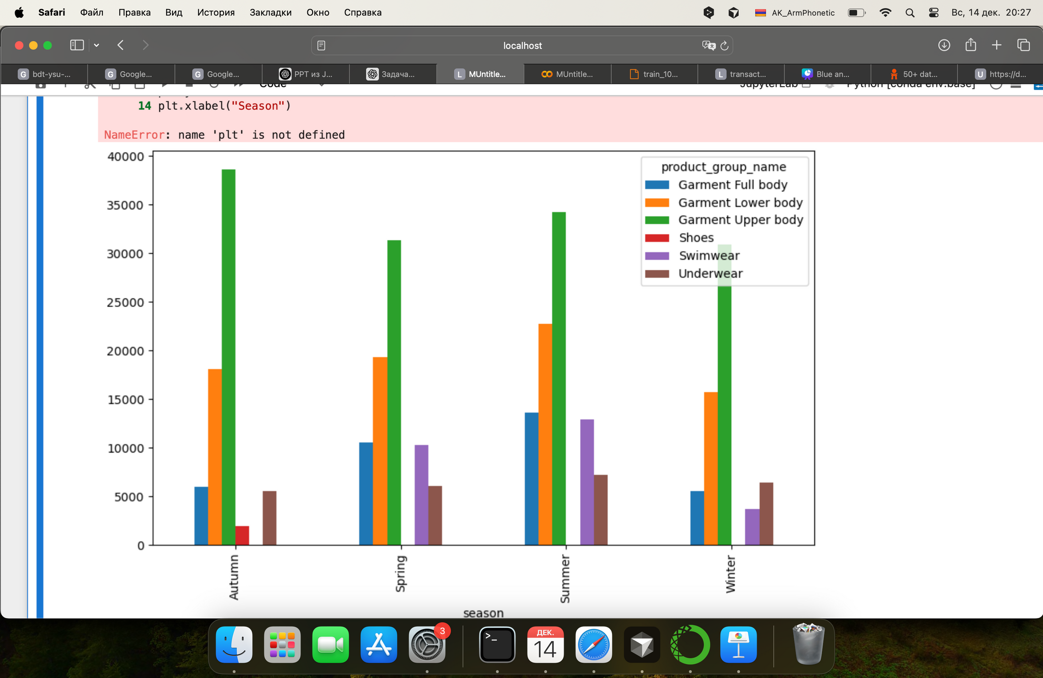
01
Seasonal trends at the product_group_name level
Top 5 product groups in each season

Slide 5
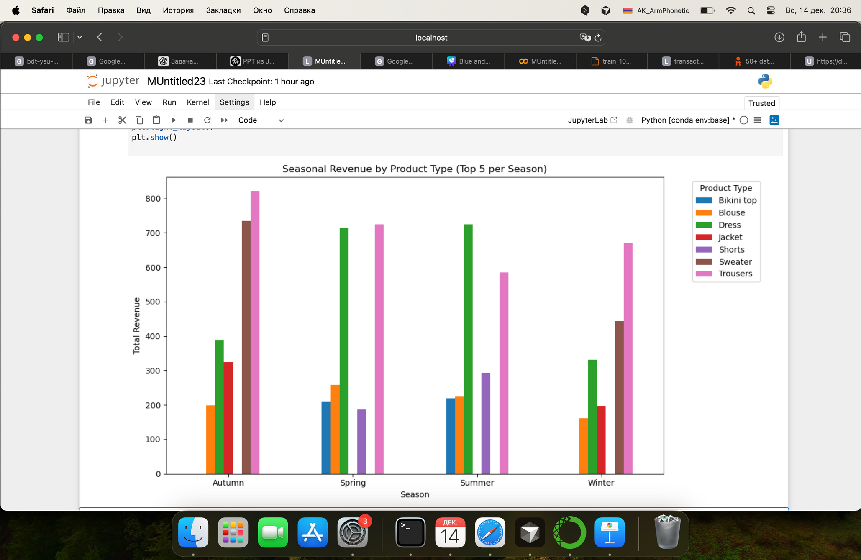
02
Seasonal trends by product type

Slide 6
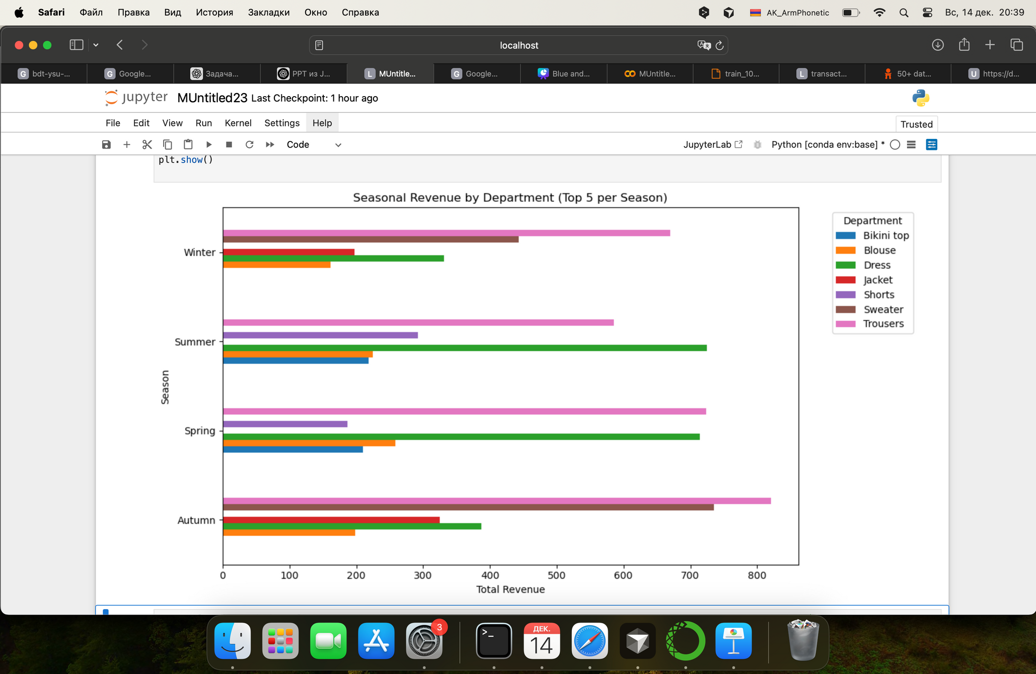
03
Seasonal trends by department name

Slide 7
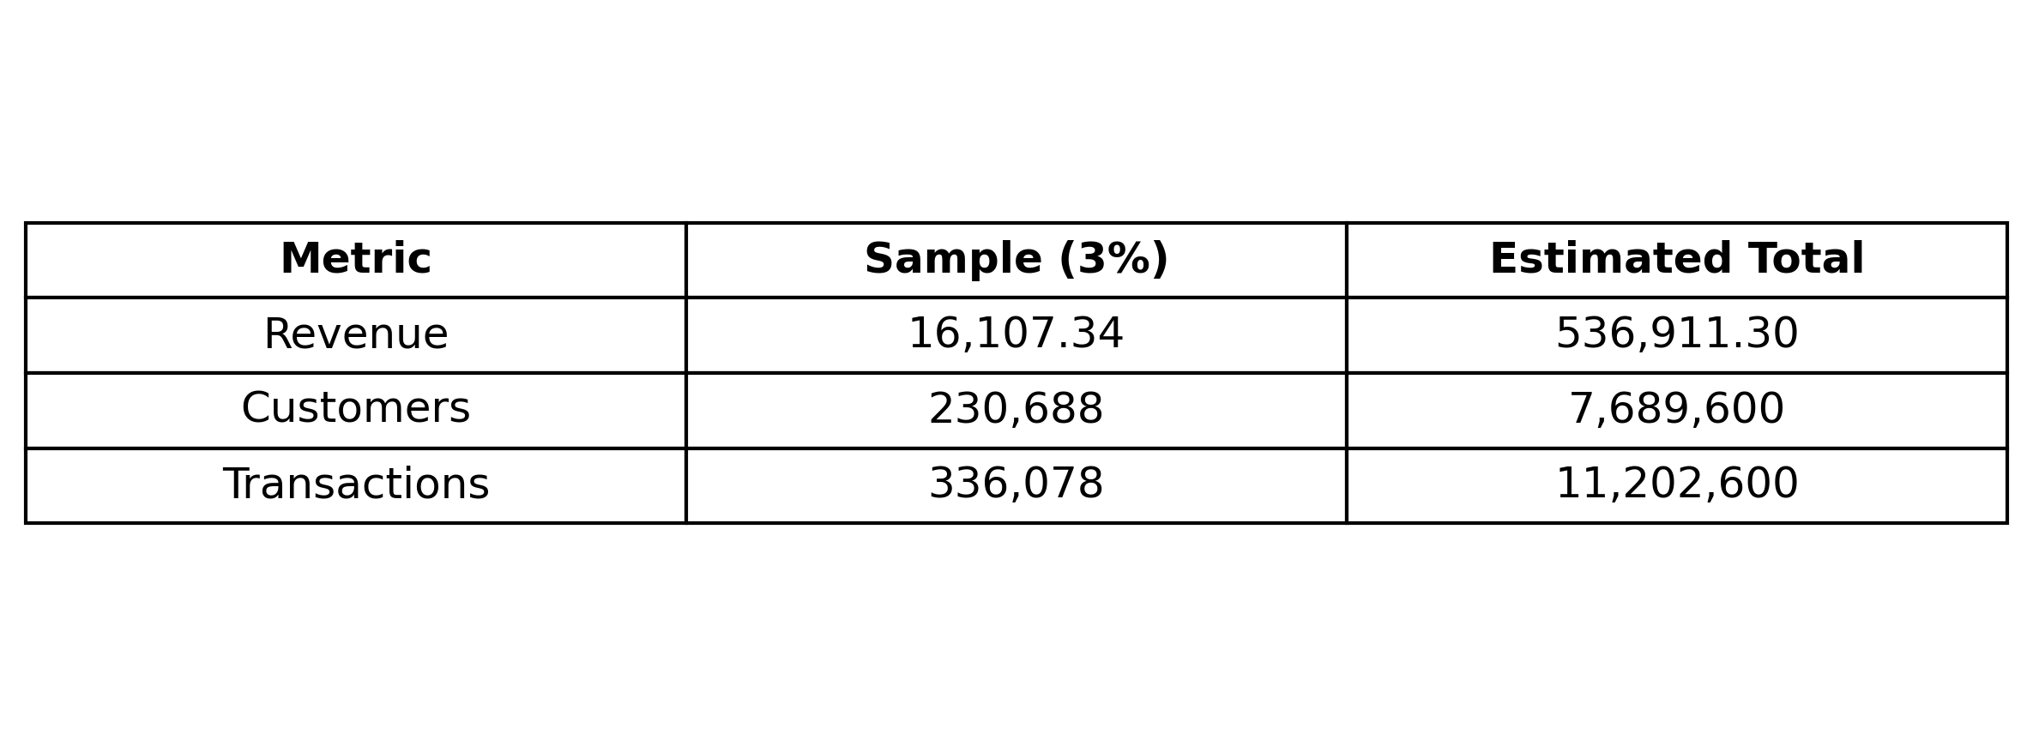
04
Population-Level Estimates (3% Sample Scaling)

Slide 8
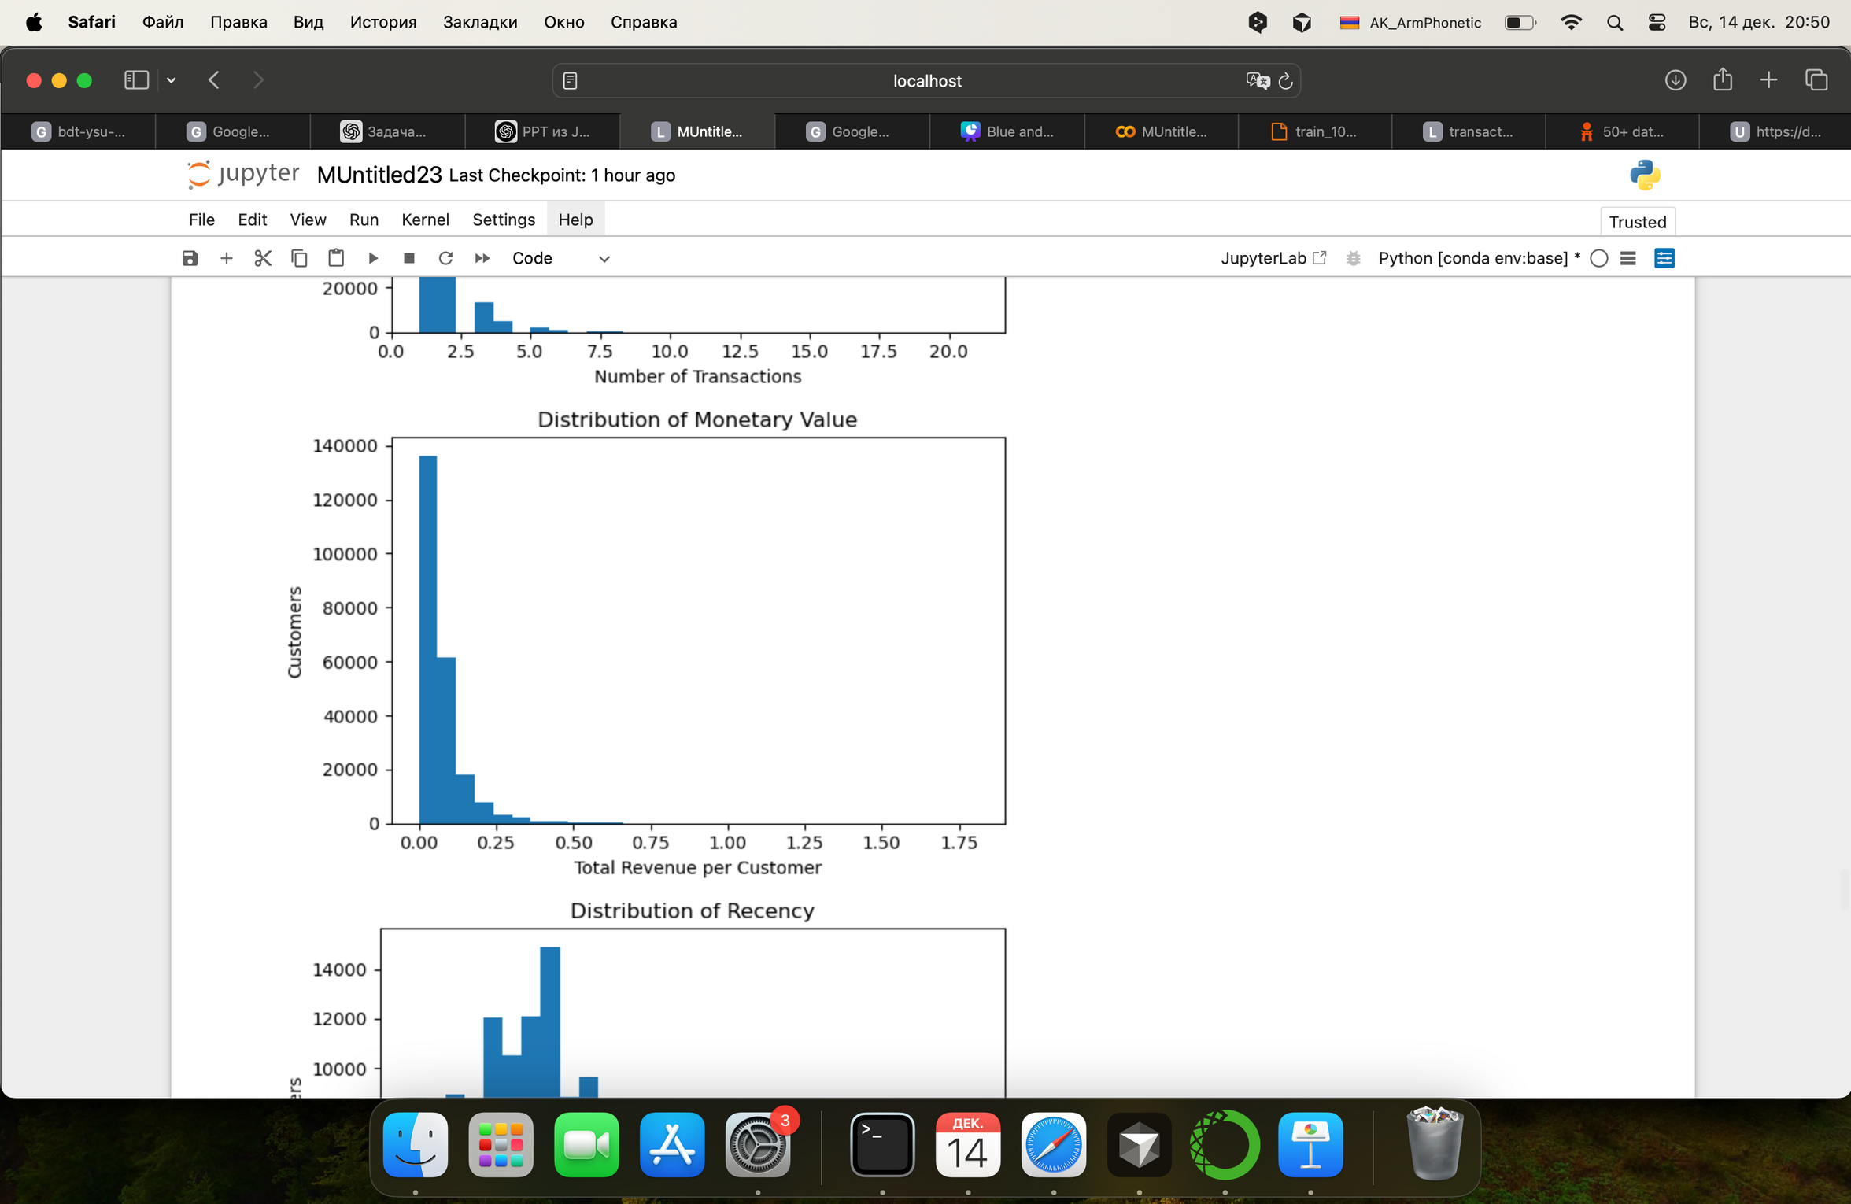
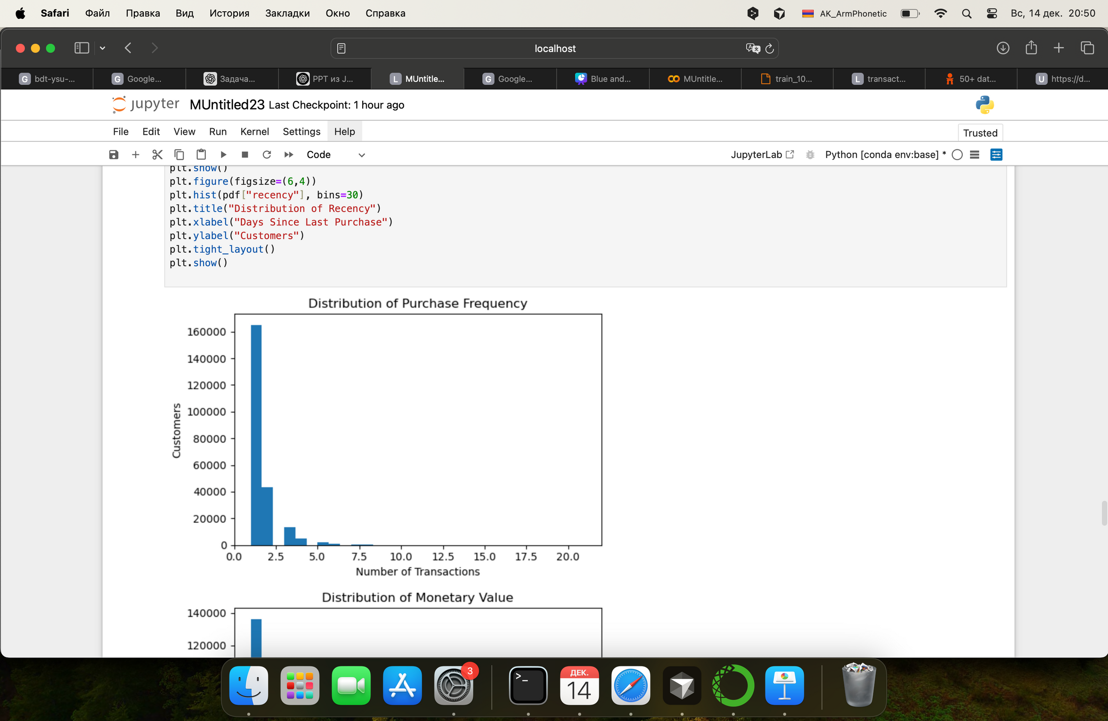
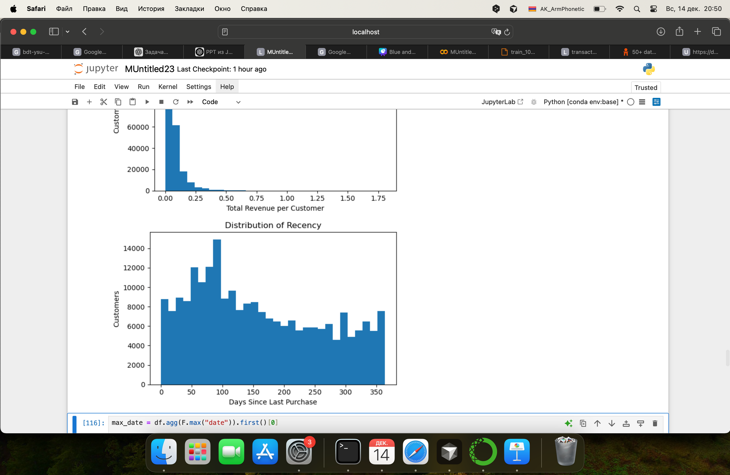
05
RMF

Slide 9
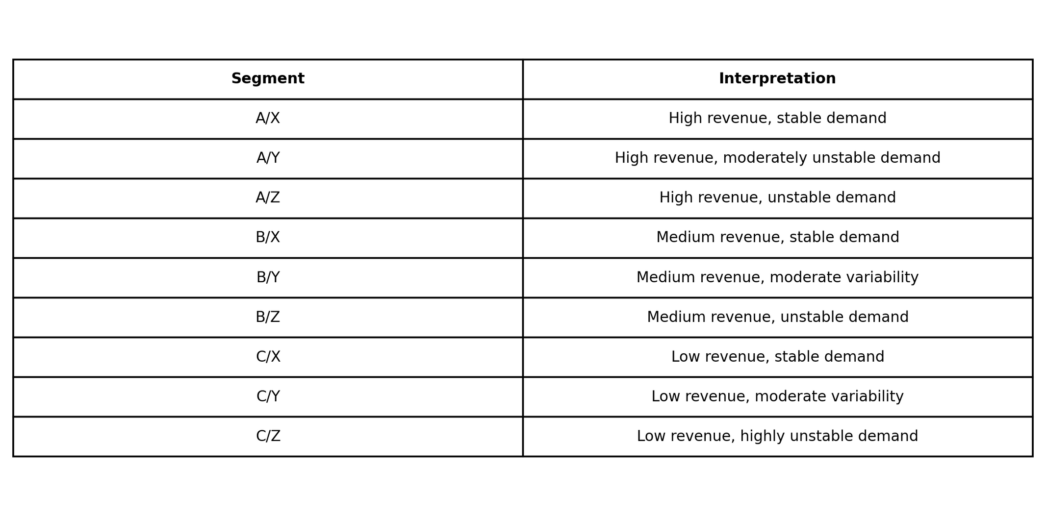
06
The most valuable segment — A/X 2 961 products
They form a significant share of income
They have stable and predictable demand
Must be always available
ABC-XYZ

Slide 10

THANK YOU
WRAPPING UP AND PARTING THOUGHTS
hello@reallygreatsite.com

